Slide 1
Statistical Simulated Models for Tornado Forecasting
MISG 2020 –Problem 5

Slide 2
Motivation
Tornados are a major disaster, therefore accurate prediction of the event is an important research activity
Long-range forecasts of severe convective storm activity is missing from seasonal forecasts such as how many storms can be expected along the a coastline etc.
Predicting tornado activity prior to the start of season has gained lots of attention in research
Because of large gaps in our knowledge of how climate influences severe weather and the lack of methods to forecast it on the seasonal scale , basic and applied research using statistical models are needed to predict severe weather conditions accurately

Slide 3
Objective
Fit/simulate statistical models to the historical tornado database is recommended
Within the current dynamic models for seasonal forecast events of interests like tornados are too small to be resolved
In dynamic seasonal models the necessary conditions do not sufficiently distinguish between days with and without tornados
In future study, two statistical models (Cohen, 2018,”Simulating Tornado Probability and Tornado Wind Speed Based on Statistical Models”) which simulate tornado potential and wind speed are used to test the SA weather database during the time period of tornado activities in SA

Slide 4
Multivariable Linear Regression Models
The statistical model for simulating tornado wind speed given a tornado is
where Y corresponds to the tornado wind speed simulated, A_{i} represents each of regression coefficients corresponding to the predictors X_{i}, m is the number of input predictors and B is the intercept value of the model
The simulated Enhanced Fujita (EF) scale ratings can be determined from the simulated tornado wind speeds by assigning ratings 0,1, 2,3,4 and 5 to the simulated wind speed of 75mph, 123mph, 151mph, 183mph and 218mph

Slide 5
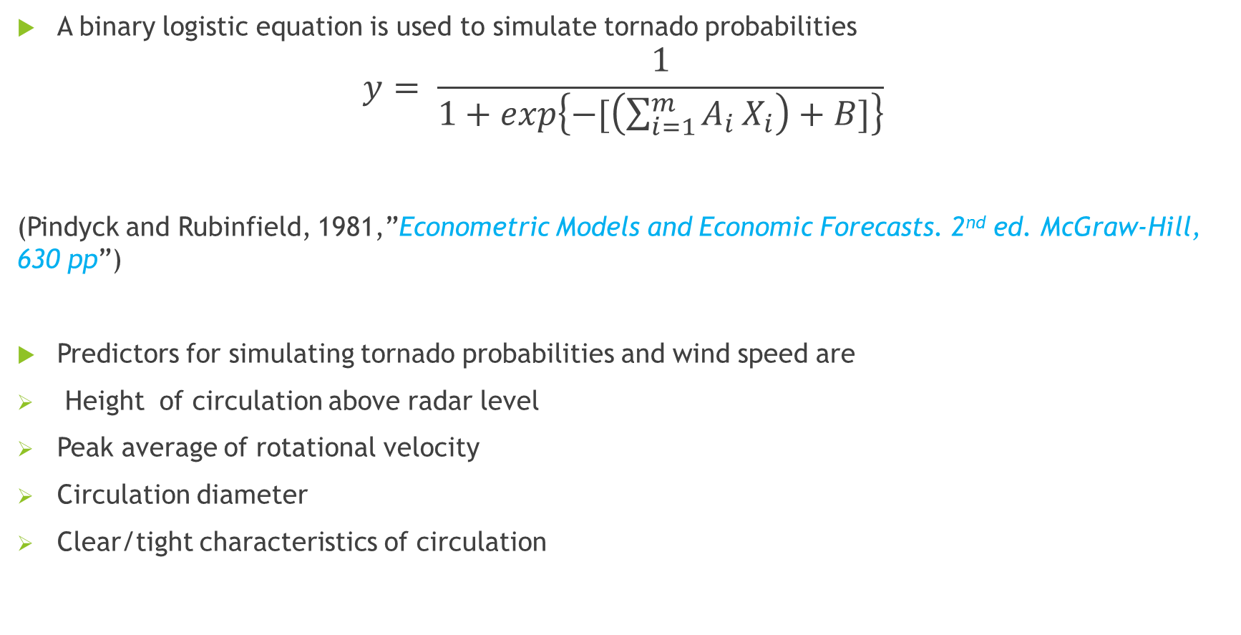
Multivariable Linear Regression Models
A binary logistic equation is used to simulate tornado probabilities
$$y= \frac{1}{1+exp\left\{−[\left(\sum_{i=1}^{m}{A_{i}}X_{i}\right)+B]\right\}}$$
(Pindyck and Rubinfield, 1981,”Econometric Models and Economic Forecasts. 2nd ed. McGraw-Hill, 630 pp”)
Predictors for simulating tornado probabilities and wind speed are
Height of circulation above radar level
Peak average of rotational velocity
Circulation diameter
Clear/tight characteristics of circulation

Slide 6
Conclusion
Inputs from the independent data set can be used to statistically simulate the tornado probability and tornado wind speed for each of severe weather conditions
Differences between values of performing the model on a dataset for which the known and unknown outcomes evaluate model for further improvements

